Slide 1
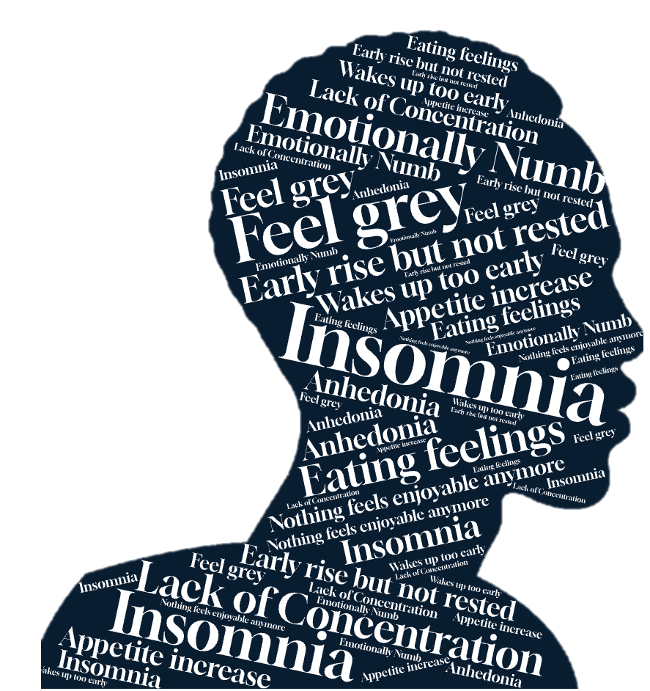
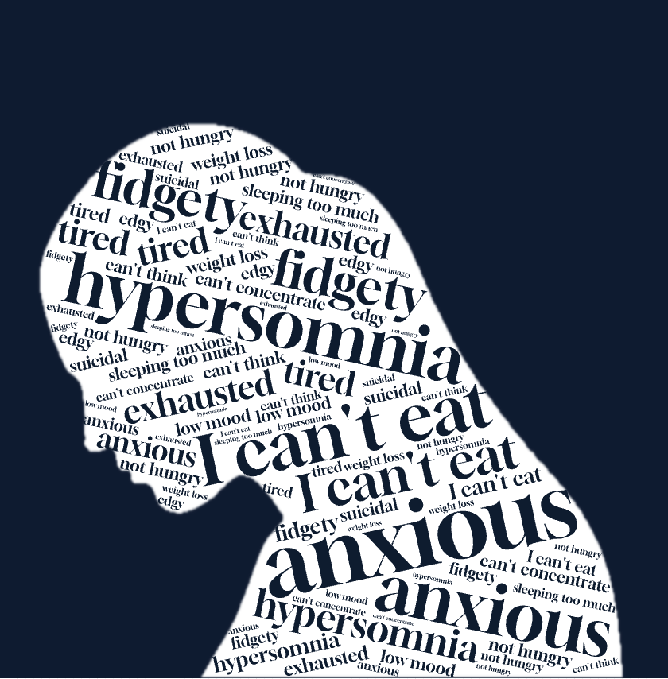
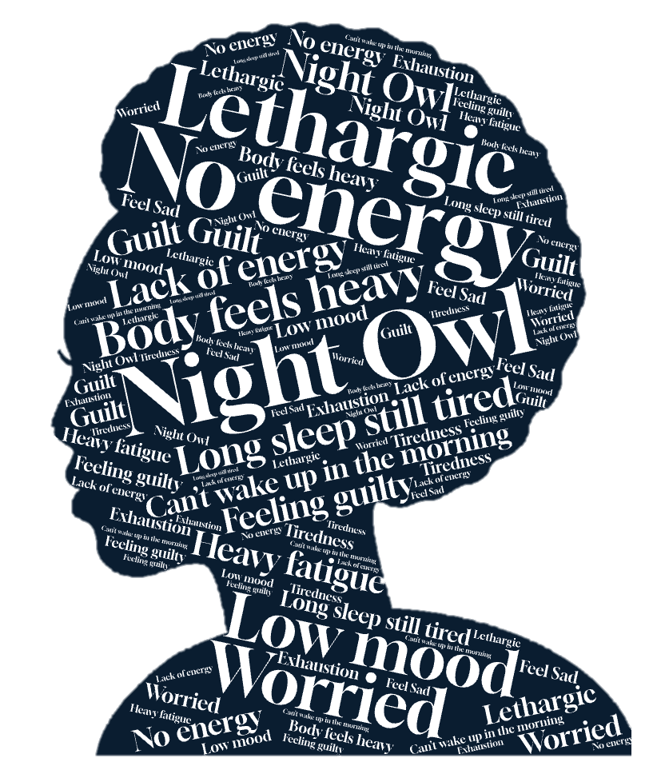
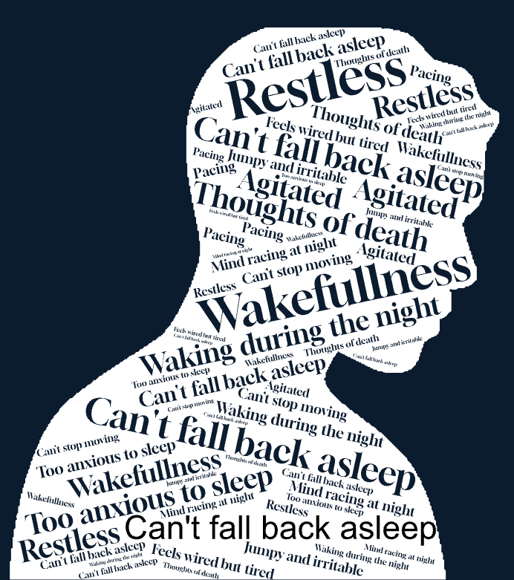
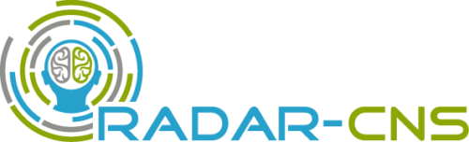

Is Depression One-Size-Fits-All?
Uncovering New Insights with Wearables
Notes:
When you hear the word depression, what comes to mind? Most people think of low mood. But depression is actually far more complex. Two people with the same diagnosis might not share a single symptom in common; this makes it hard to characterise the population as a single homogenous group. So far, our understanding has relied on self-report symptom measures, which are often biased and limited in scope. Wearables offer continuous, objective tracking of behaviours. Using this data, we can identify patterns that help us group people with depression into smaller, more manageable clusters, which could improve outcome prediction.

Slide 2
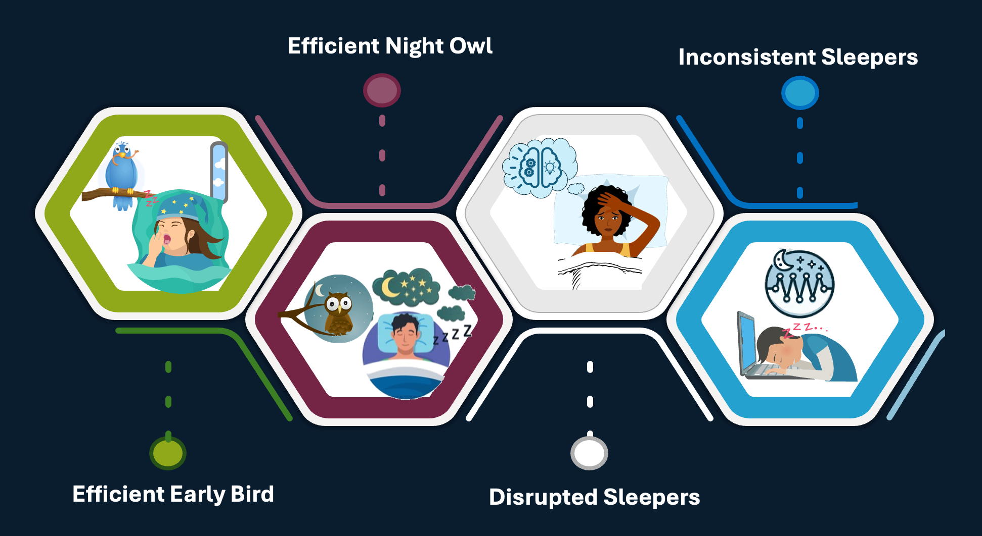

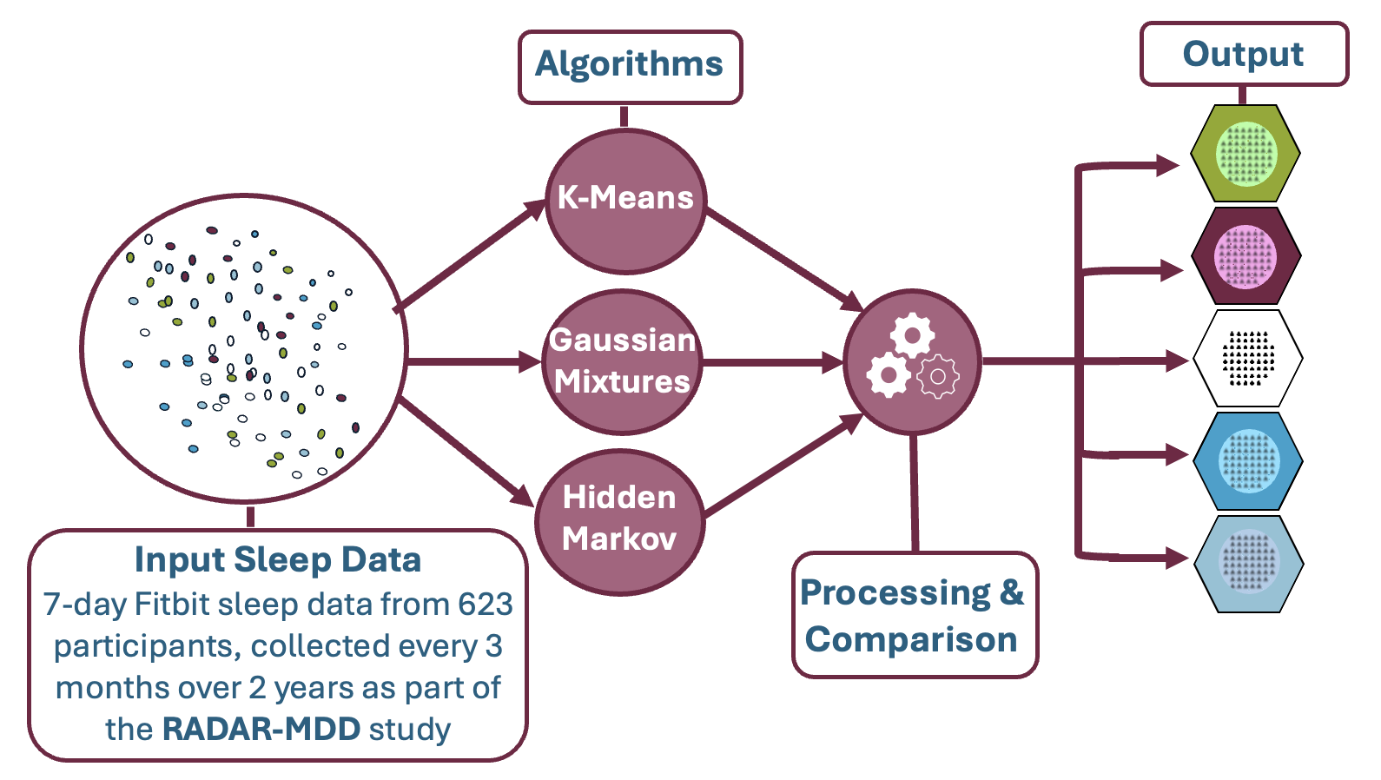

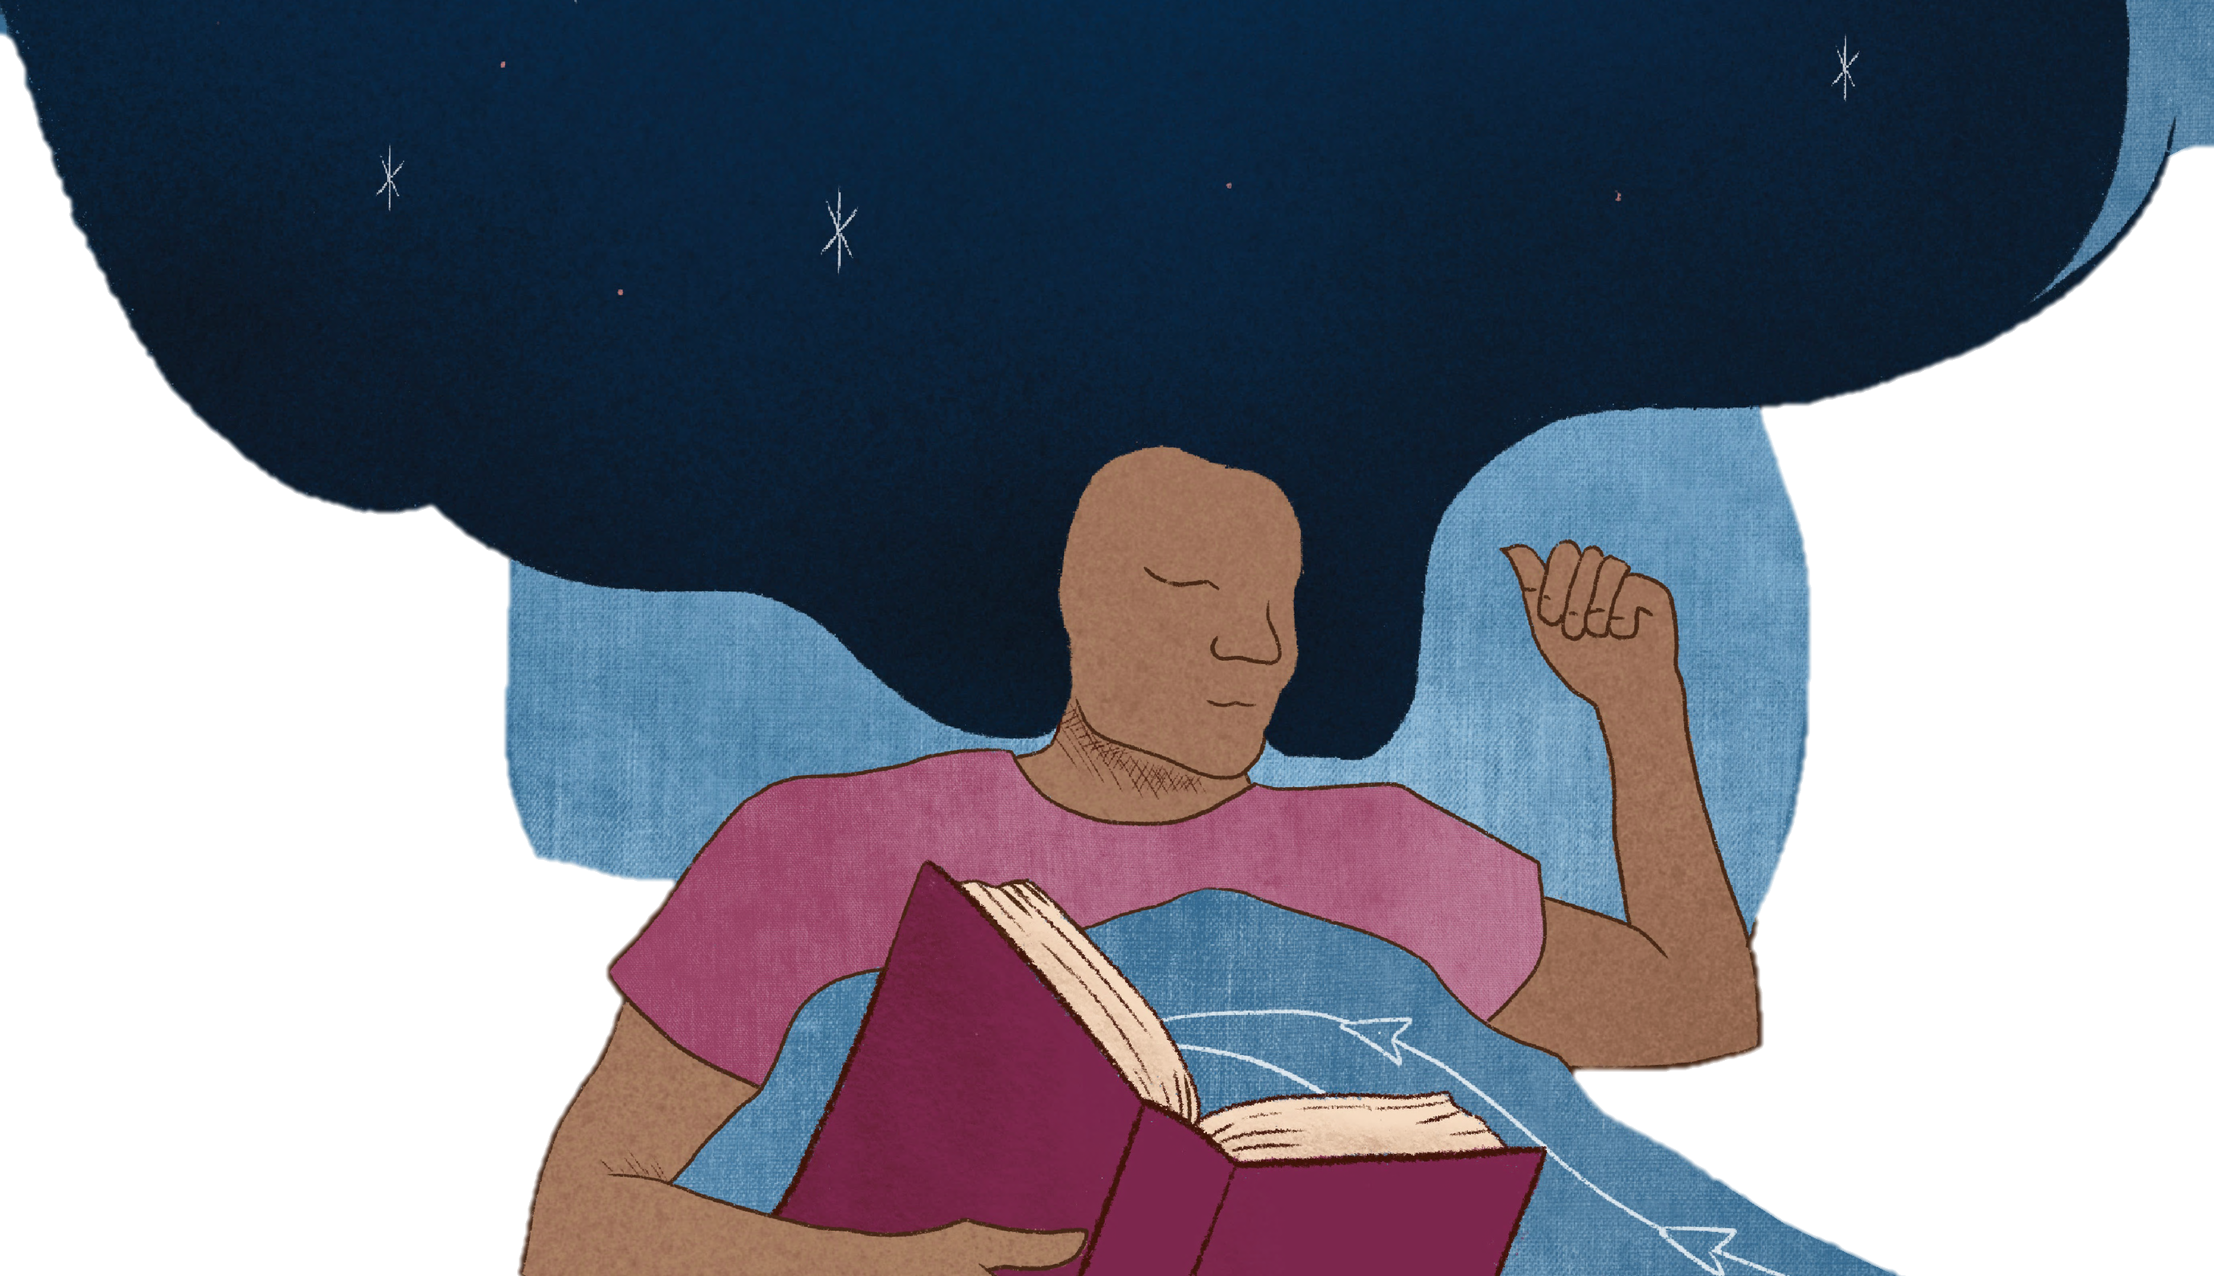
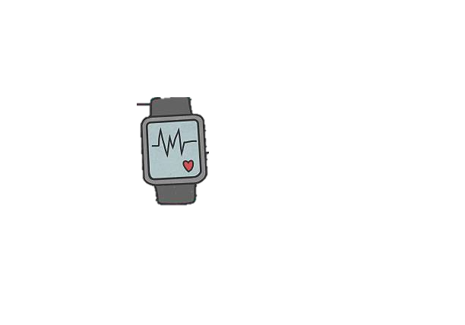
Efficient Night Owl
Inconsistent Sleepers
RADAR-MDD
623 participants
Fitbit x 2 Years
Unsupervised Clustering
Gaussian Mixture &
Hidden Markov Models
Efficient Early Bird
Disrupted Sleepers
Notes:
Our study, RADAR-MDD (using the radar-base technology you already heard about), collected two years of wearable sleep data from 623 participants with a history of depression; due to this long follow-up, patient involvement was key from design to publication to ensure high-quality data collection and interpretation.
To investigate our subtypes, we first focused on sleep because 90% of depression patients report poor sleep as a key symptom of their depression. Using machine learning, we identified four distinct sleep phenotypes: The efficient early bird and efficient night owl two groups with varying onset and offset times but similarly efficient sleep with few awakenings. Disrupted Sleepers – who have frequent/long awakenings, and finally Inconsistent Sleepers, those with variable sleep patterns over time. Interestingly, these clusters weren’t tied to clinical factors (such as age, gender), suggesting intrinsic sleep differences. Plus people stayed in the same cluster over time, reinforcing idea of stability.

Slide 3
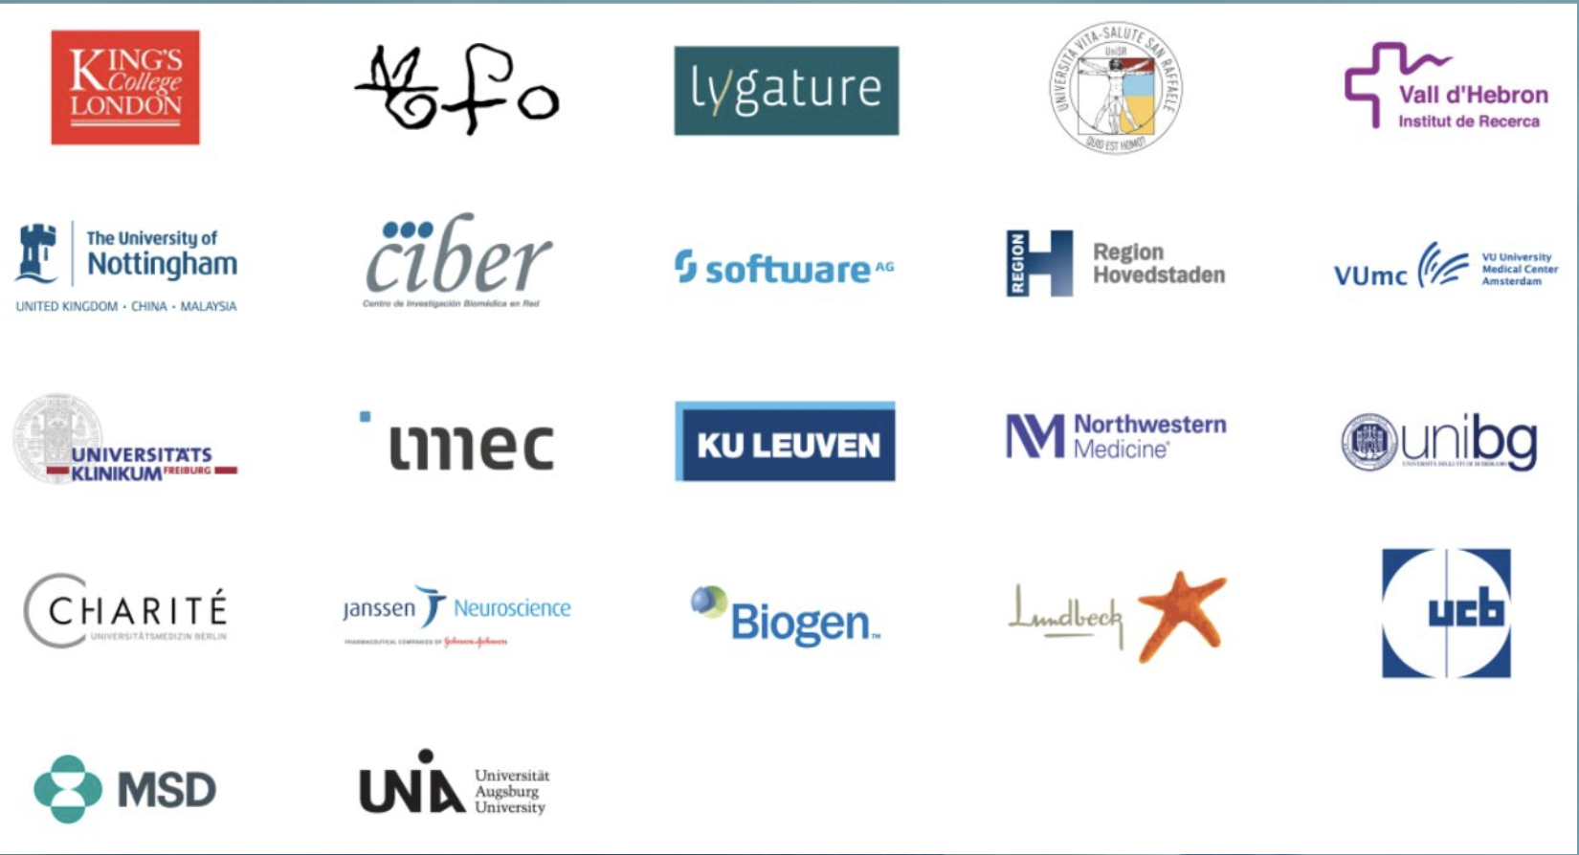
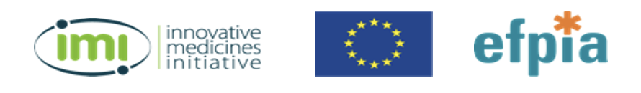

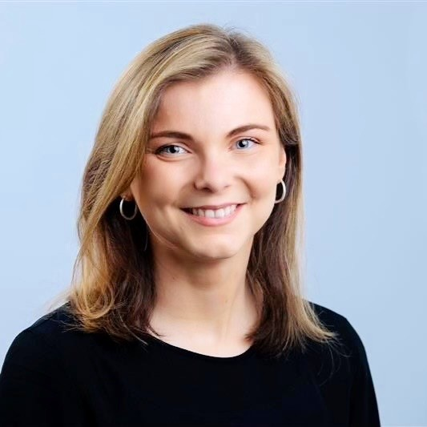
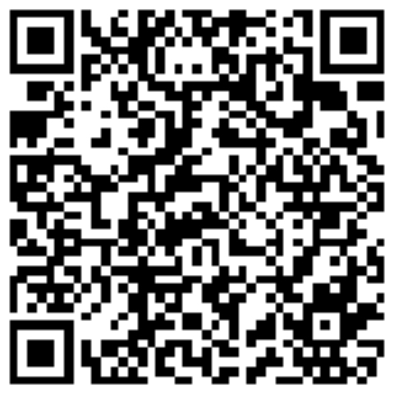
Now what?
Test prediction accuracy
Consult with PAB
Repeat subtyping with other measures
🔍
Thank you to our funders, the Patient Advisory Board (PAB) and the RADAR-CNS consortium
Open to new ventures.
Let’s connect!
carolin.1.oetzmann@kcl.ac.uk
linkedin.com/in/carolin-oetzmann/
Notes:
Next, we tested whether these sleep subtypes can improve predictions of depression, returned to our patient advisory group to see how these results aligned with lived experiences and repeated the process with new measures. Ultimately, we believe that unpicking the heterogeneity of depression using remote sensor data could lead to better outcome prediction and treatment matching to improve the lives of those with depression. I am finishing my PhD in merely a month, so I want to thank everyone involved, from collaborators to patients and funders. Come find me if you want to hear how the project continued - as this is only a small chunk of the much larger thesis project.

